Slide 1
Welcome, to the New World!
Encountered a red character.
You obtained useful information about where to rest this night.
Speak to obtain possibly some beneficial information.
Talk
Nearest tavern. (Cost is negotiable + information)
Tavern
Start
Begin your travel to finding a place to stay at.
Don’t bother with this young beggar.
Leave
At a local farmers hut. (Free of charge if persuaded)
Hut
Say nah I am not playing this game. (Exit Game)
Exit
You reach the tavern and ask the owner about staying tonight. The cost is 10 gold coins.
Give him the money.
Pay

Slide 2



Solid:
Title
Read Text Event on Tile Selected by Player
Ice:
Area:
XII
XII
XII
XII
IX
III
IX
III
IX
III
IX
III
ActnBtn
VI
VI
VI
VI
Result of Action Button Clicked
XII
XII
XII
XII
IX
III
IX
III
IX
III
IX
III
VI
VI
VI
VI
XII
XII
XII
XII
IX
III
IX
III
IX
III
IX
III
VI
VI
VI
VI

Slide 3






Abandoned Shelter
You and your crew stubble across on what appears to be like an abandoned shelter.
Abandoned Shelter
You and your crew stubble across on what appears to be like an abandoned shelter.
Stage Initiate
Inspect
Search
Leave
Fail
Success
Fail
Success
Exit
Stage State
Area1_F
Area1_S
Area1_F
Area1_S
Inspect
Search
Leave
or
Inspect
Search
Leave
Send one soul to inspect and get a solid report of the area.
Send your crew to scavenge for fuel and supplies.
It is to risky let try another time when its safe.
Send one soul to inspect and get a solid report of the area.
Send your crew to scavenge for fuel and supplies.
It is to risky let try another time when its safe.
Stage, Title, RdTxt1, RdImg1, ActionBtns, Success, Fail
Ice1_0,
Area1_0, Abandoned Shelter, stg0, ShelterImg, Inspect|Search|Leave|, pct*50|reportIcon*1|actnPnt*-1, pct*50|cree*-1|actnPnt*-1
Success
50%
50%
Fail
Success
50%
50%
Fail
+1
-1
-1
-1
+?
+?
-1
-?
-1
Fail
Success
Success
Fail
Abandoned Shelter
The inspection was a fail, our crew mate never returned and we have no information on this area.
Abandoned Shelter
The inspection was a success, the area is safe and has x fuel and y supplies for scavenge.
Abandoned Shelter
The search was a success, in this process we gained x fuel and y supplies.
Abandoned Shelter
The search was a fail, we lost x crew members to a polar bear. The rest barely made it out alive.
Scout
Investigate
Abandon
-
Collect
Set Sail
-
-
Done
-
-
Flee
We could try and find the lost soul, but there is no guarantee.
Send your crew to find out what the problem is?
Definitely not worth going in there.
-
Send your crew to collect fuel and supplies.
Seems safe why leave now?
-
-
Nothing left to do but leave the area.
-
-
Well that was catastrophic but could have been worse.
Success
25%
75%
Fail
Success
100%
0%
Fail
Success
-
-
Fail
Success
-
-
Fail
+?
+?
-1
-?
-1
+x
+y
-1
Success
Fail

Slide 4
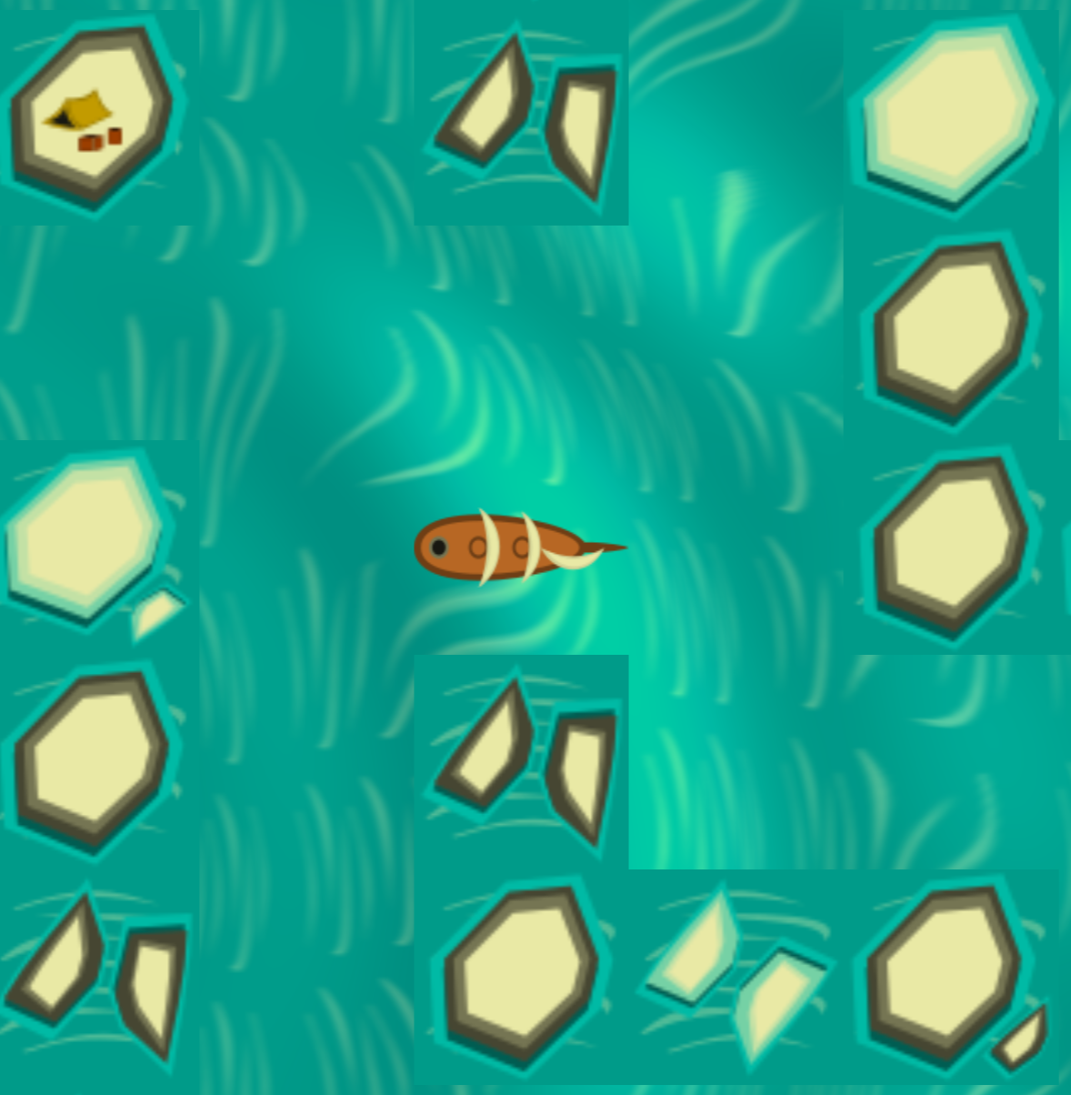
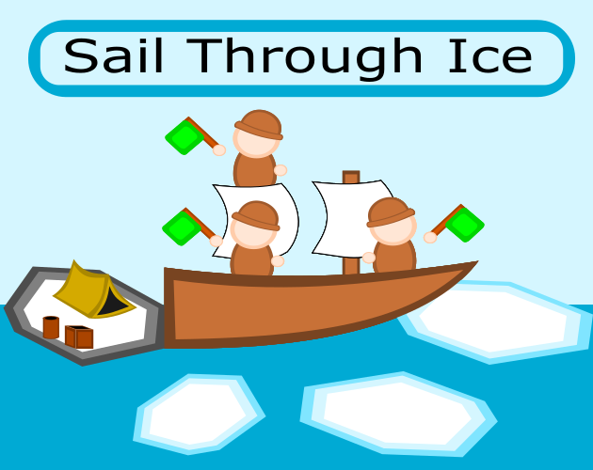
Sail through Ice

Slide 5
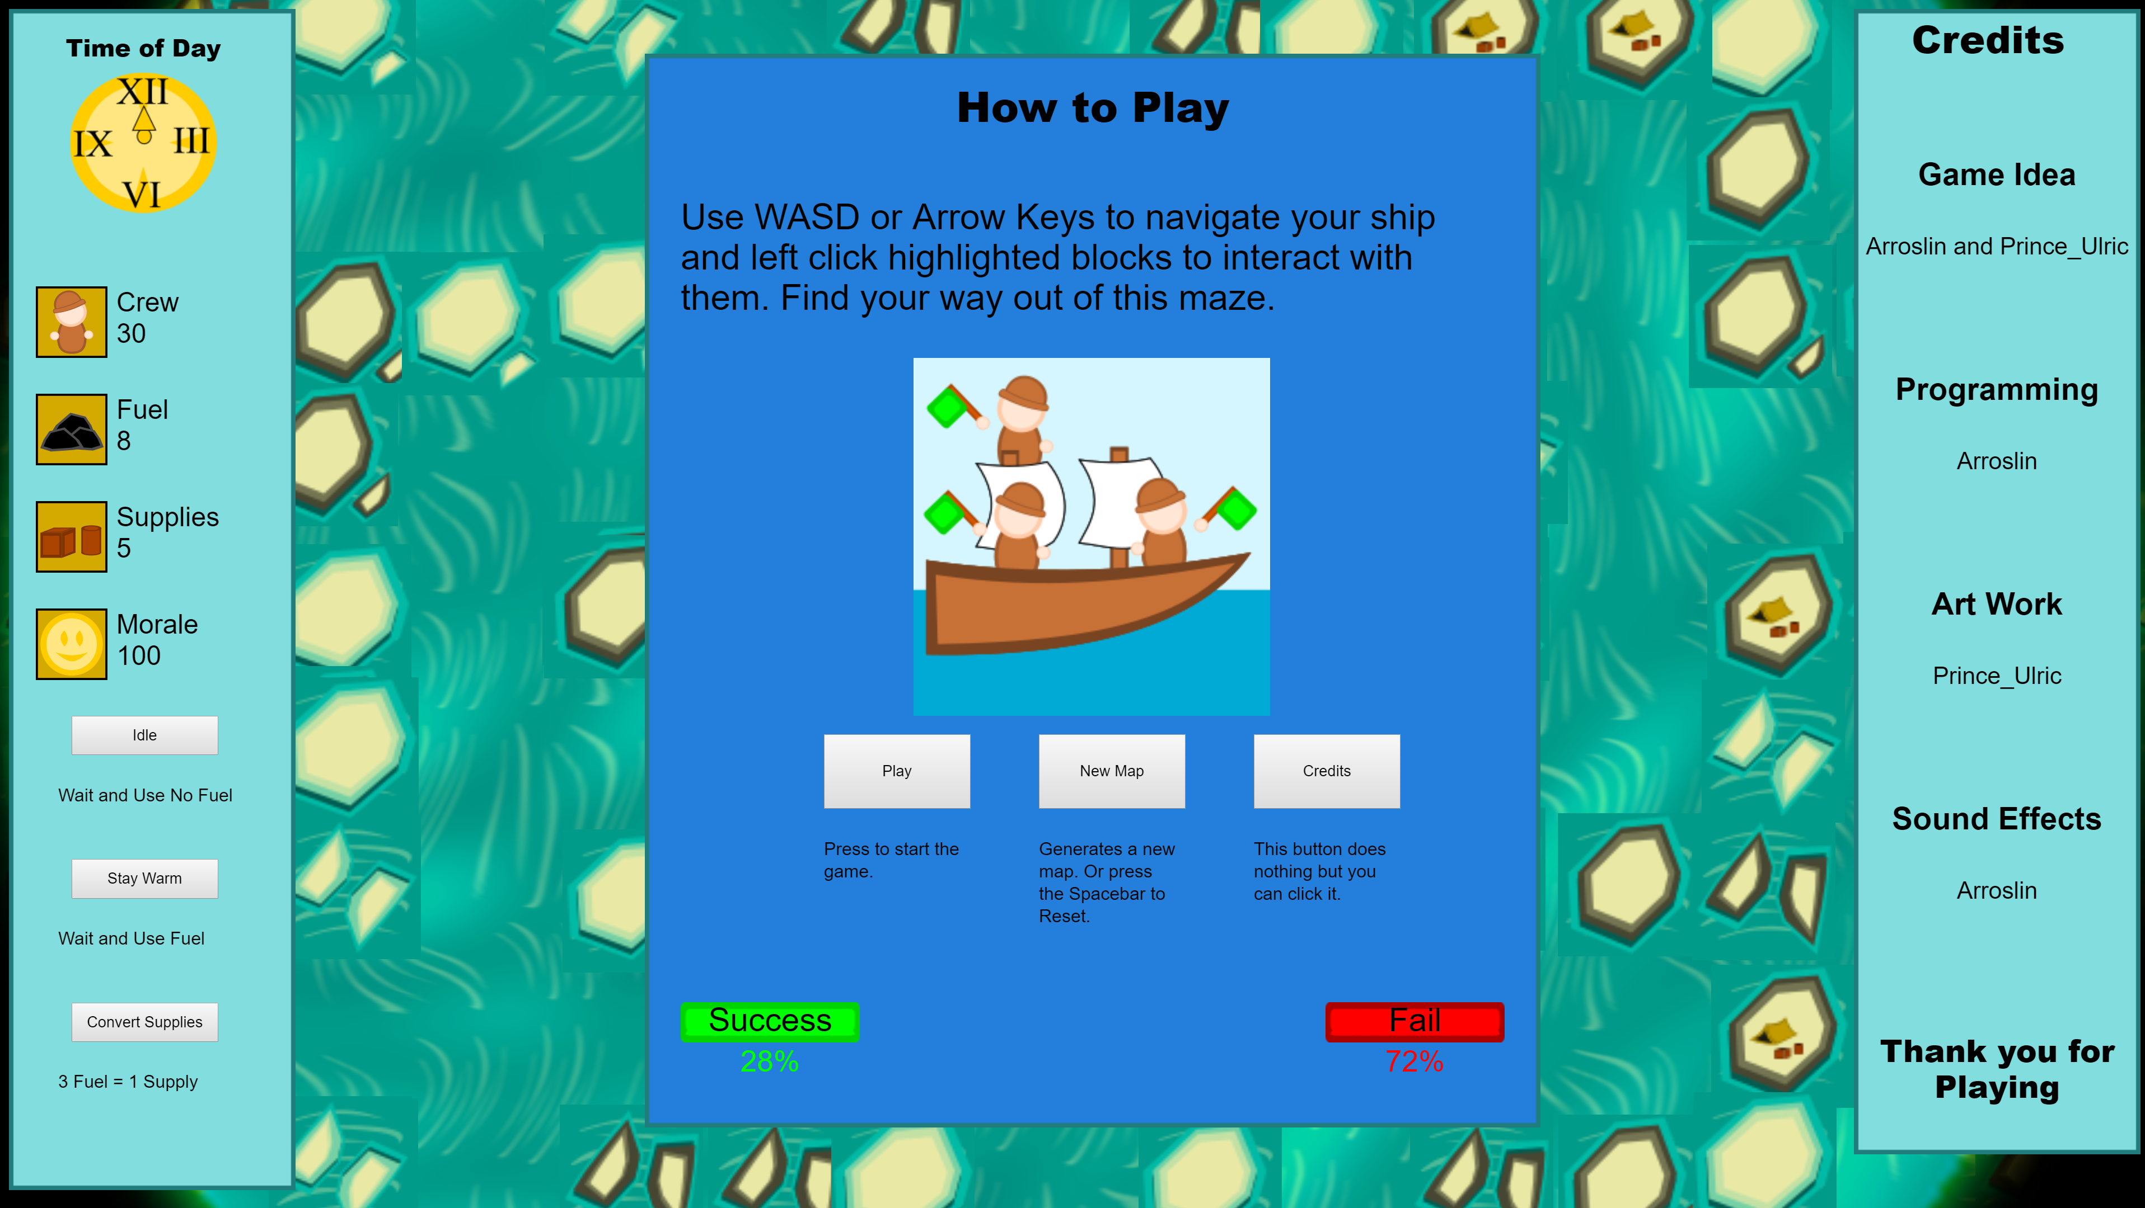

Slide 6
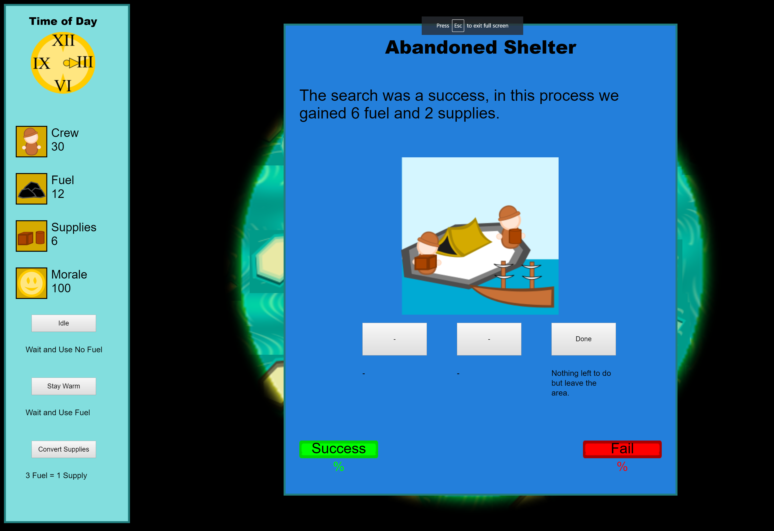

Slide 7
